Slide 1
Efficient Dimensionality Reduction Technique on Streaming Data
Supervisor : Prof. Dr. Matthias Jarke
Dr. Christoph Quix
Advisor : Arnab Chakrabarti
KHAN HAFIZUR RAHMAN
Master Thesis

Slide 2
Streaming Data : Definition
Source produce data continuously
Represent current state of dynamic systems
2 V: Velocity, Volume
Relatively expensive user-defined computations
Examples :Urban Traffic monitoring, stock trading , Sensor data

Slide 3
Streaming Data : challenges
Availability : Only once
Time : Real time or almost real time
Latency : low
Partition technique : k-way partitions
Dynamic adaption : flow rate, buffer utilization
Fast algorithms : computationally efficient

Slide 4
Dimensionality Reduction: Pros & Cons
Advantages :
Storing Data efficiently
Speed up querying procedure through applying indexing structure
Data visualization
Disadvantage:
Information loss

Slide 5
State-of-the-art Dimensionality Methods
Feature Extraction Algorithm: Extract features by projection of high-dimensional space into lower dimensional space.
Always apply linear algebraic transformation to find optimal solution
Examples :
Linear Discriminant Analysis
Maximum Margin Classification
Principle Component Analysis

Slide 6
State-of-the-art Dimensionality Methods
Feature Selection Algorithm: Greedy approach by aiming to find subset of most representative features based on some criteria
Difficult to find the optimal solution
Examples :
Orthogonal Centroid algorithm

Slide 7
Limitation of State-of-the-art Dimensionality Methods
All algorithms consider data are available
Matrices computation in batch mode
Not scalable
Computation & Storage complexity
Input : row = 64 ; Columns = 88
Output :
d = 5632
co-variance matrix : d*(d+1)/2 = 15,862,828 entries

Slide 8
Solution of State-of-the-art Dimensionality Methods
Collect data whenever new data are presented and apply batch learning approach on collected data so far
Limitation :
Large memory to store data
High Computational expenses
Forget the knowledge that acquires in past batch mode

Slide 9
Solution of State-of-the-art Dimensionality Methods
Incremental method has one-pass incremental learning
Retain knowledge about the past but not the training samples
Propose algorithm based on updating Eigen space models but one Eigen space model at each time
Propose algorithm without using covariance metrices; rather use Gaussian distribution
QR decomposition approach where whole input is not saved

Slide 10
Motivation
Data information is loss
No stable dimensionality reduction algorithm so far for streaming data
Look into different approach: available are Network theory , Compression, Data deduplication, Data reordering
Our approach : Data reordering
Reason for the approach : No information loss as its just the reordering of the features; so we can get back to original data

Slide 11
Thesis Goal
Handle Streaming data through sliding window approach
Send one window data to Entropy Minimization Dimensionality Reduction Framework
Visualize result through Heat map method
Implementation of Incremental Linear Discriminant Analysis and also visualize through Heat map method
Compare the visualization based on some evaluation criteria

Slide 12
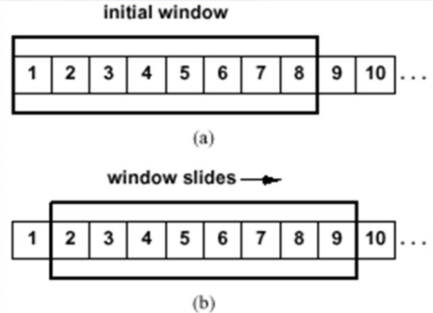
Sliding Window approach
As the name says a window structure that can slide on data
Slide a box around data and analyze data on each box
Box are having fixed width for example, data arrives in each 5 seconds
Apply proposal methods on each window
Notes:
Image : https://www.google.de/search?q=Sliding+window+approach&rlz=1C5CHFA_enDE667DE667&source=lnms&tbm=isch&sa=X&ved=0ahUKEwiq1qiBnefWAhXFXBoKHfDKBPYQ_AUICigB&biw=1422&bih=640#imgrc=vziq7beDqxIIRM:

Slide 13
Entropy Minimizations algorithm
Differential Predictive Coding to encode dataset and to formalize the reordering criterion
An expectation-Maximization like algorithm to minimize entropy of the DPC residuals
TSP-means algorithm is used as a TSP-solver

Slide 14
Linear Discriminant Analysis
Compute d-dimensional mean vectors
Compute the Scatter Matrices for both within-class and between-class
Solving the generalized eigenvalue problem for the matrix
Selecting linear discriminants for the new feature subspace
Transforming the samples onto new subspace

Slide 15
Incremental Linear Discriminant Analysis
As new samples are added, the original mean vector is changed
Mean vector has impact on both within class and between class scatter matrices
Incremental handled in two ways :
Sequential Incremental LDA
Chunk Incremental LDA

Slide 16
Evaluation Criteria
Quantitative Evaluation: Defining the matrices
Qualitative Evaluation:
Evaluating result through visualization
Reordering methods give better visualization or not
Perform both algorithm for different streaming data based on application fields

